Slide 1
ENGLISH
PRESENTATION
Battiato
Paolini

Slide 2
Phishing
01
02
Identity theft
Copyright
Piracy
03
04
When someone try to trick you by sending you phony emails, links to fake website…
When your private information is stolen and used for criminal activity.
Copyright is a legal concept that gives the creators of original works exclusive rights over their creations.
Piracy refers to the unauthorized use or reproduction of another person's or entity's intellectual property, such as copyrighted material, without the owner's permission.

Slide 3
01
Phishing

Slide 4
WHAT DOES IT MEAN?
CYBER
ATTACK
A phishing attacker creates a fake email or website that looks like something you trust or want to use, such as a bank or social media site

Slide 5
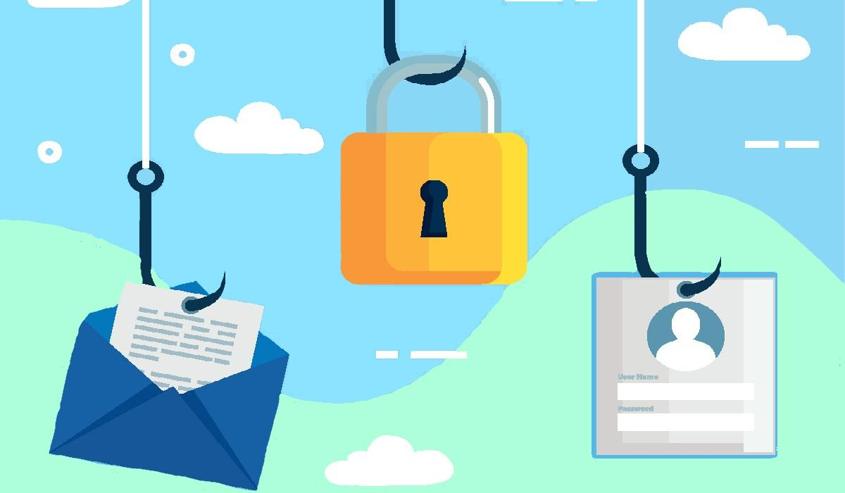
Phishing
Imagine you are a fish swimming in a lake, and a fisherman throws a baited hook.
The bait looks like something you want to eat, so you take the bait and end up getting hooked.
Bill Gates

Slide 6
EXAMPLES
Email
Fake website
Message
Apparently to be from legitimate sources such as banks.
A copy of the look of a legitimate websites such as banks.
Such as SMS to send fraudulent messages to their targets.

Slide 7
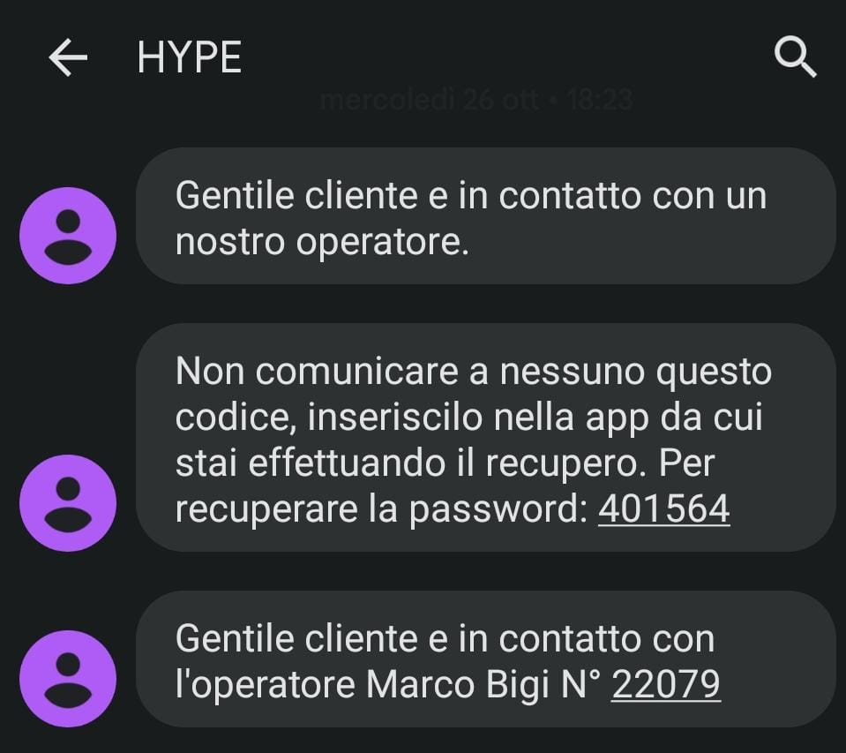
PERSONAL EXAMPLE

Slide 8
PREVENTION
Problem
Solution
Phishing can cause identity theft, financial loss, malware infections, reputation damage, and time and productivity loss.
To protect yourself from phishing attacks, it's important to be cautious and verify the details.

Slide 9
02
IDENTITY THEFT

Slide 10
WHAT DOES IT MEAN?
ATTACK
Is a type of crime in which your private information is stolen and used for criminal activity.
PREVENTION

Slide 11
IDENTITY THEFT CAUSES
Money losses
Credit damage
Be blackmailed
Unauthorized charges or fraudulent transactions made using the victim's financial information.
Refers to the negative impact on the victim's credit score pretending to be that person.
threatens to expose embarrassing or damaging information about the victim.

Slide 12
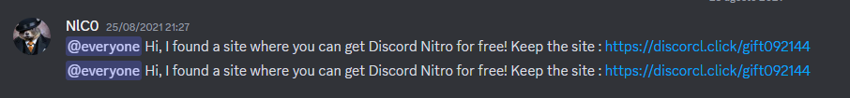
PERSONAL EXAMPLE

Slide 13
03
Copyright

Slide 14
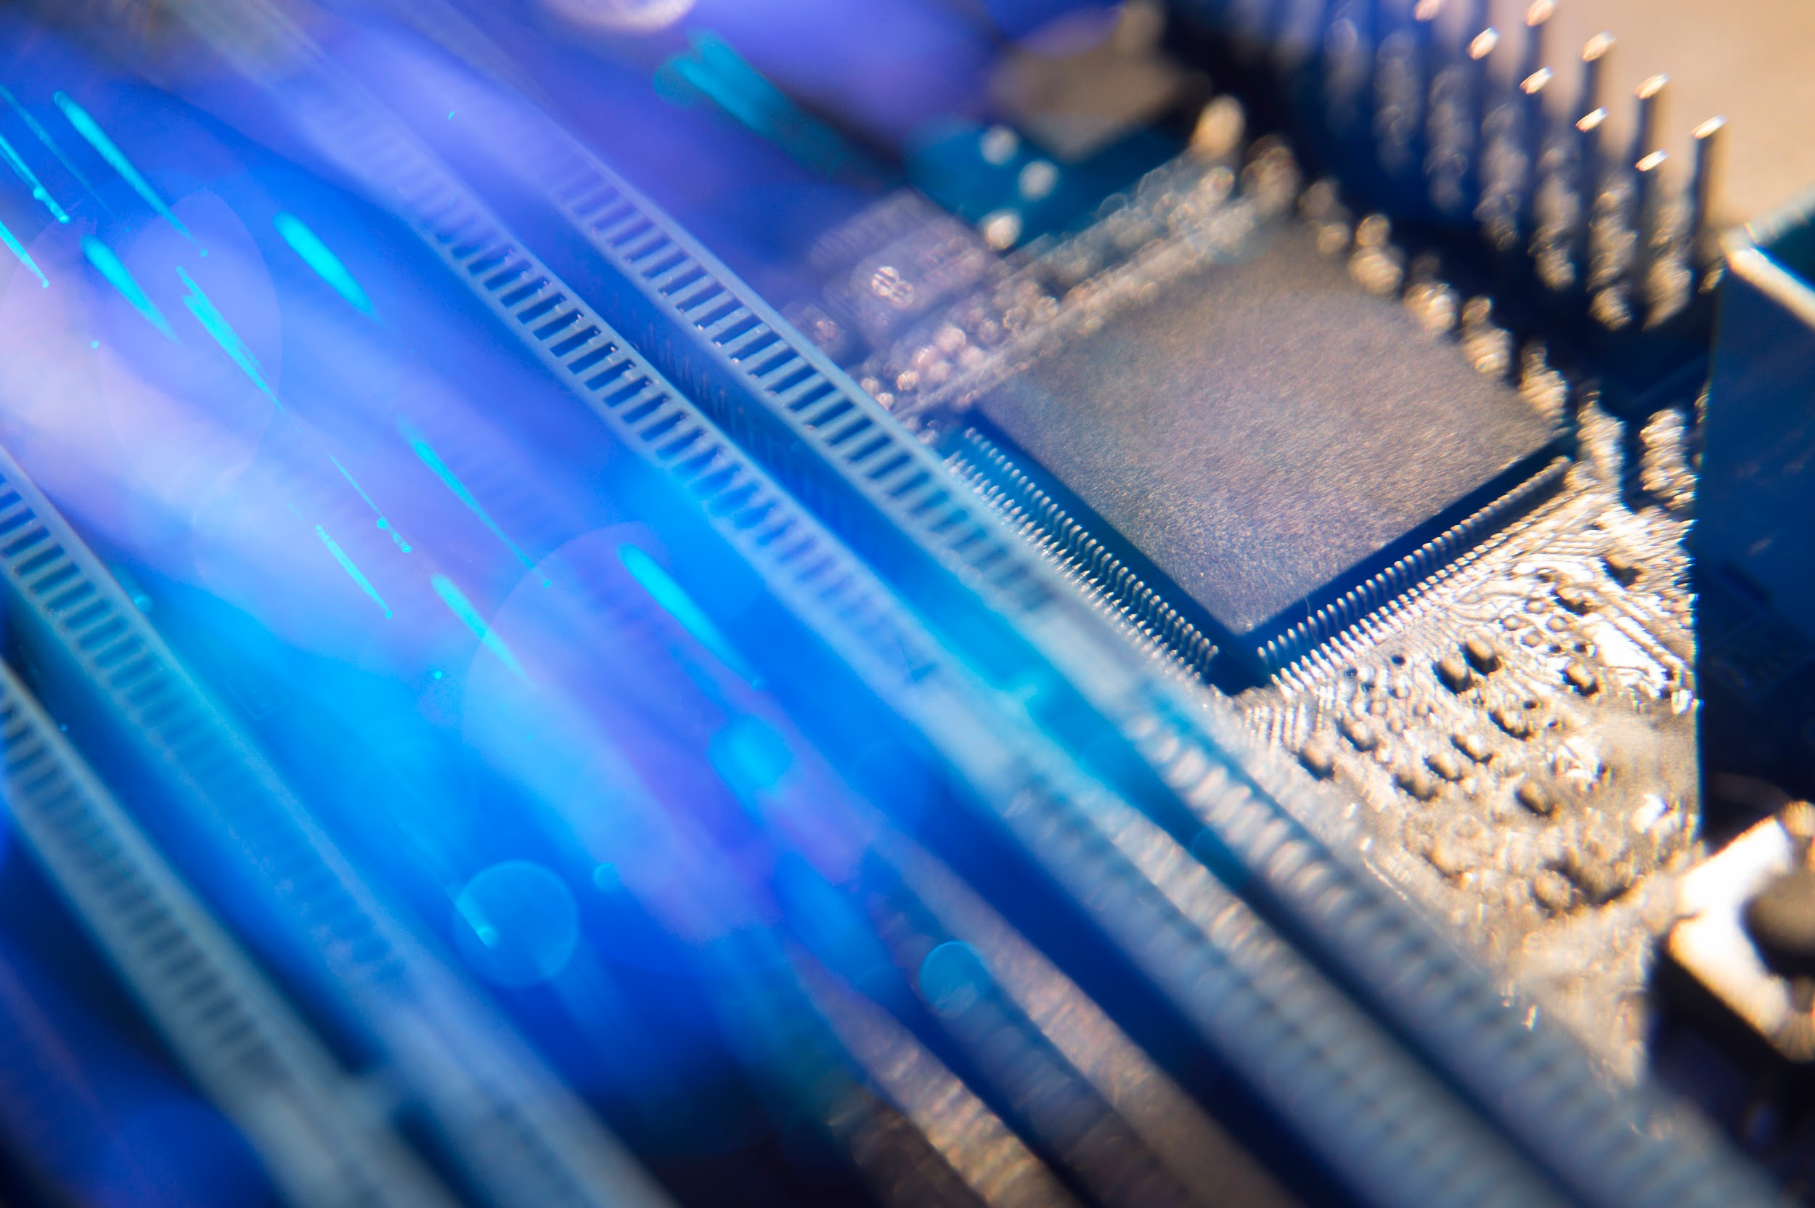
What is it?
copyright means that if you create something original, you have the right to control how it is used and distributed. This means that others cannot copy, distribute or use your work without your permission.

Slide 15
OUR SERVICES
If someone infringes on a copyright by using or reproducing a copyrighted work without permission, the copyright owner has the right to take legal action.
To protect their copyright, creators can also use tools such as digital rights management technologies. Additionally, creators can use licensing agreements to allow others to use their works under certain conditions, such as paying a fee or giving credit to the creator.

Slide 16
Example
An example of copyright in informatics would be a software developer who creates a computer program.
The copyright in the software protects the developer's exclusive right to control how the program is used and distributed.

Slide 17
04
Piracy

Slide 18
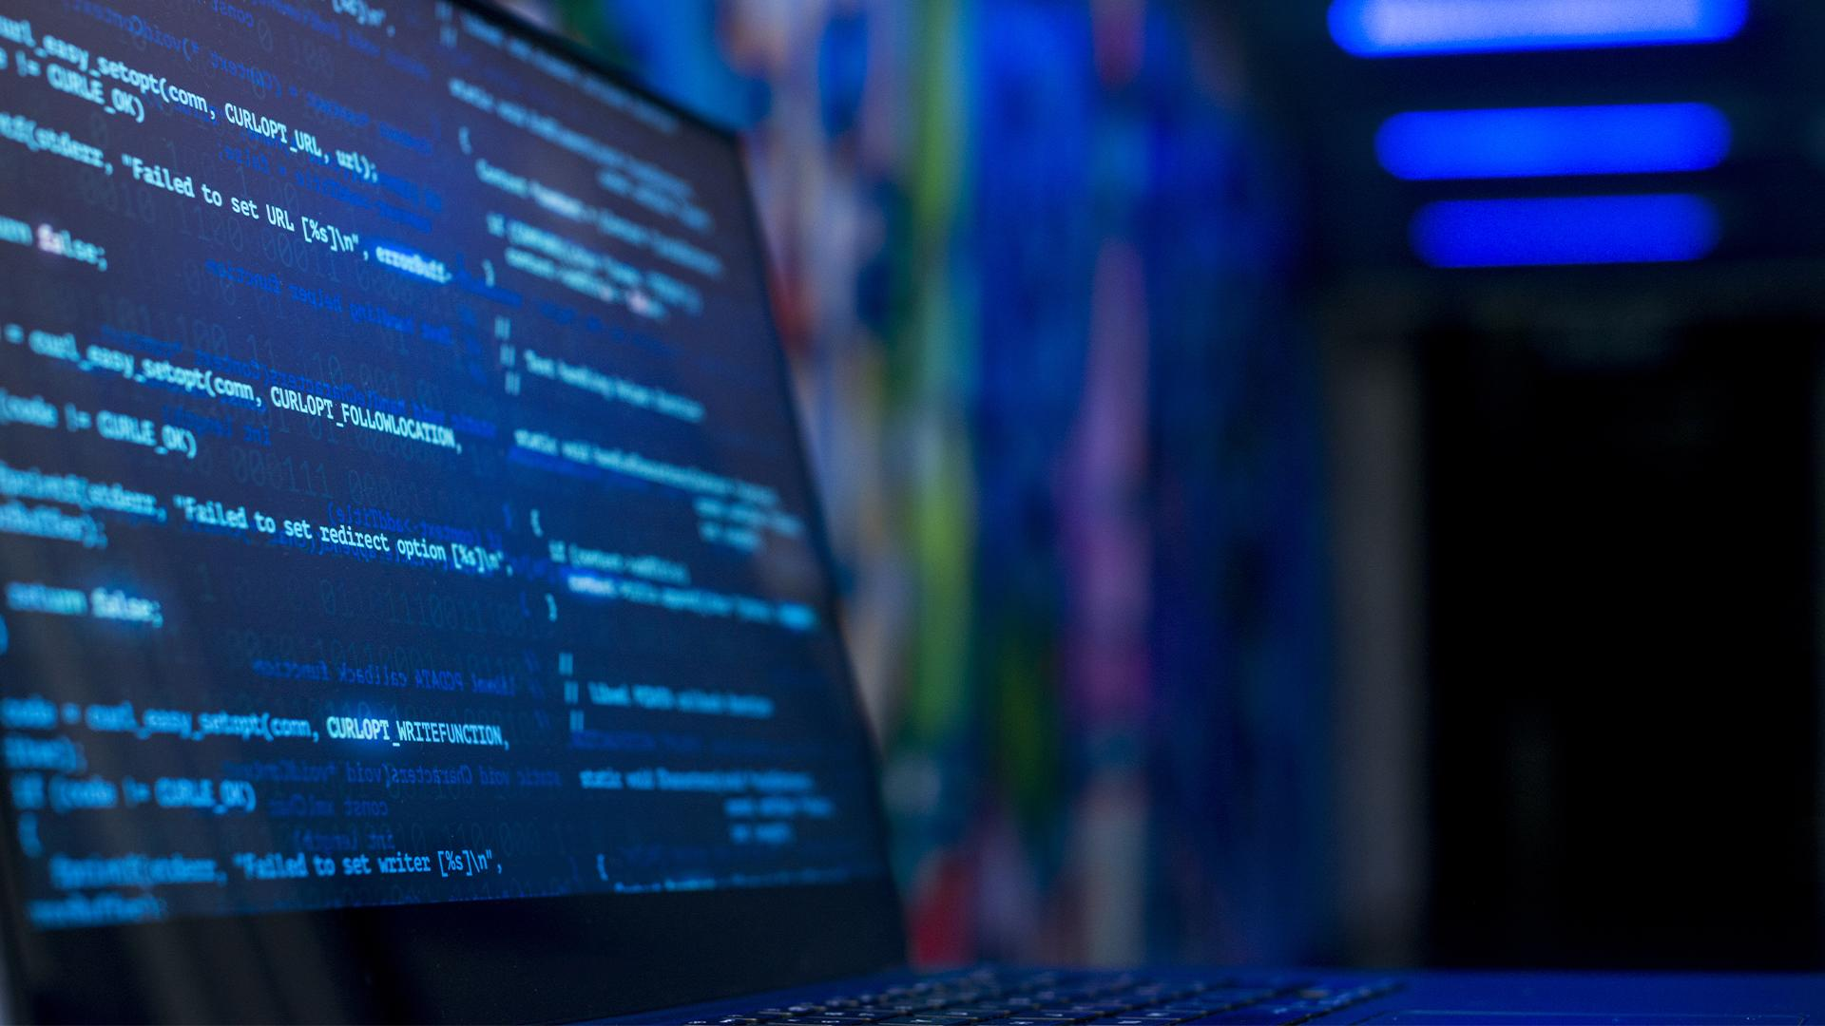
What is it ?
Piracy refers to the act of illegally copying or distributing someone else's creative work, such as music, movies, books, software, or other digital media, without permission.
This can include downloading or sharing copyrighted material.
Piracy is illegal and can result in legal action.

Slide 19
Example
An example of piracy in informatics would be someone making unauthorized copies of a software program and distributing those copies to others without permission from the software's owner.

Slide 20
How to protect my data form piracy?
Some simple steps you can take to protect your data from software piracy:
Use strong password
Use anti-virus software
Backup your data
Secure your network

Slide 21
Some dates
The global software piracy rate was 32% in 2020
The software piracy rate in Italy was 42% in 2020

